Slide 1

Cluster analysis and Semantic Vector Spaces
Natalia Levshina ©2017
Jena, WiSe 2017-2018

Slide 2
Outline
Principles of hierarchical cluster analysis
Case study: how do dogs bark?
Semantic Vector Space Models
Case study: English verb classification

Slide 3
How do dogs bark in different languages?
English: bow wow
German: wau wau
Russian: gav gav
> dogs <- c("bauwau", "vauvau", "gavgav")

Slide 4
Levenshtein (edit) distances
Minimal number of insertions, deletions and substitutions needed to transform one string into another.
> dogsdist <- adist(dogs)
> dogsdist
[,1] [,2] [,3]
[1,] 0 2 4
[2,] 2 0 4
[3,] 4 4 0
> rownames(dogsdist) <- c("en", "de", "ru")
> colnames(dogsdist) <- c("en", "de", "ru")
> is(dogsdist)
[1] "matrix" "array" "structure" "vector"

Slide 5
Transform to a distance matrix
> dogsdist
en de ru
en 0 2 4
de 2 0 4
ru 4 4 0
> dogsdist <- as.dist(dogsdist)
> dogsdist
en de
de 2
ru 4 4
> is(dogsdist)
[1] "dist"

Slide 6
Hierarchical cluster analysis: steps
Pick the smallest distance between two objects in the distance matrix and merge them in one cluster.
Then pick the next smallest distance between two objects and/or clusters and merge them.
Stop when all objects are merged in one cluster tree.

Slide 7
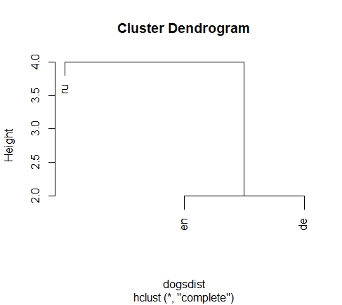
hclust
> plot(hclust(dogsdist))

Slide 8
Clustering methods
OK, but how to compute distances between clusters?
Single (the minimally possible distances between the clusters are compared, and the smallest is taken)
Complete (the maximally possible distances between clusters are compared, and the smallest is taken)
Average (the average distances between the clusters are computed, and the smallest is taken)
Ward (based on variance minimization)

Slide 9
A simple analogy
Imagine you have a choice between two clubs. How do you decide which one to join?
Single: you choose the club your best friend has joined.
Complete: you find out which club your biggest enemy is a member of. You choose the other one.
Average: you choose the club which has on average more likable members.
What is your own social strategy?

Slide 10
Hierarchical clustering with hclust
> plot(hclust(dogsdist)) #complete
> plot(hclust(dogsdist, method = "single"))
> plot(hclust(dogsdist, method = "average"))
> plot(hclust(dogsdist, method = "ward.D2"))

Slide 11
Exercise
Three students wrote an essay about sexual harassment. Mary wrote “harassment”, Pete wrote “harrassment”, and Bill wrote “herasment”. Can you tell who is more likely to have cheated, using edit distances and cluster analysis?

Slide 12
Outline
Principles of cluster analysis
Case study: how do dogs bark?
Semantic Vector Space Models
Case study: English verb classification

Slide 13
Semantic Vector Space Models
Main inspiration:
“You shall know the word by the company it keeps” (Firth 1957)
Words that occur in the same contexts tend to have similar meaning (Harris 1959)
Origins in Computational Linguistics (cf. Deerwester et al. 1990, Schütze 1992, Lin 1998)
Various applications in lexical and constructional corpus-based semantics (e.g. Levshina & Heylen 2014; Perek 2016)

Slide 14

A compact overview for linguists
See my paper with Kris Heylen (Levshina & Heylen 2014)

Slide 15
The main steps
1. Create the vectors of co-occurrence frequencies of target words and contextual features (other words, subcategorization frames, etc.).
2. Normalize the frequencies (usually by transforming them into Pointwise Mutual Information scores), so that more surprising frequencies get more weight.
3. Compute the distances between the vectors (usually using the cosine measure).
4. Perform cluster analysis, MDS or use another exploratory technique.

Slide 16
What are contextual features?
Bag-of-words models:
Take all words that occur within a certain window around a word (e.g. 5 words on the left and 5 words on the right).
Large window: topic-related information
-5 | -4 | -3 | -2 | -1 | 0 | 1 | 2 | 3 | 4 | 5
I | wandered | lonely | as | a | cloud | that | floats | on | high | ov’r

Slide 17





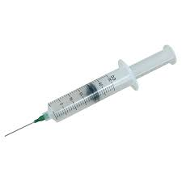
Topic: hospital

Slide 18
What are contextual features like?
Bag-of-words models:
Take all words that occur within a certain window around a word (e.g. 5 words on the left and 5 words on the right).
Small window: semantic relatedness
-5 | -4 | -3 | -2 | -1 | 0 | 1 | 2 | 3 | 4 | 5
I | wandered | lonely | as | a | cloud | that | floats | on | high | ov’r

Slide 19
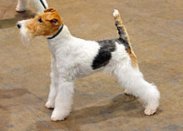
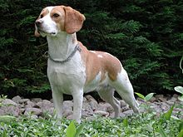
Some semantic relationships
Synonyms, e.g. begin – start
Co-hyponyms, e.g. fox terrier – beagle
Hyper- and hyponyms, e.g. dog - beagle
Images from Wikipedia

Slide 20
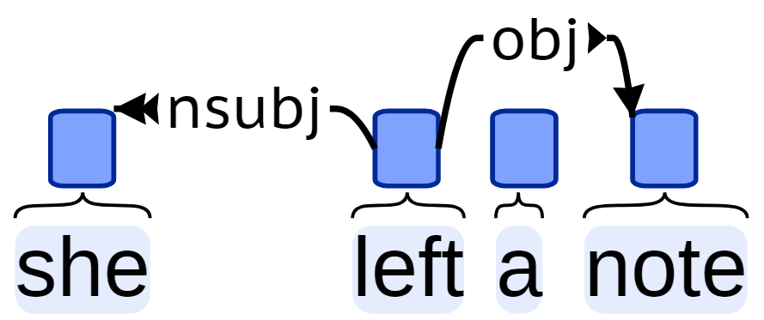
What are contextual features like?
Syntactically enriched models:
Take into account the syntactic dependencies between the targets and other lexemes
Good for capturing semantic similarity.
Image from http://universaldependencies.org/u/overview/simple-syntax.html

Slide 21
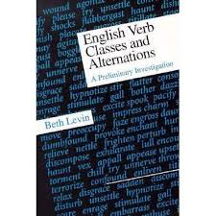
What are contextual features like?
Fully syntactic information
E.g. subcategorisation frames for verbs, such as Subj_V_Indirect Object_Direct Object.
Yields classes similar to Levin’s (1993)

Slide 22
Of cabbages and kings (COCA)
 | vegetable.n | grow.v | crown.n | royal.adj | make.v | …
cabbage | 76 | 43 | 3 | 1 | 109 | …
king | 11 | 90 | 134 | 236 | 1122 | …
queen | 3 | 92 | 56 | 127 | 312 | …
… | … | … | … | … | … | …

Slide 23
Of cabbages and kings (COCA)
 | vegetable.n | grow.v | crown.n | royal.adj | make.v | …
cabbage | 76 | 43 | 3 | 1 | 109 | …
king | 11 | 90 | 134 | 236 | 1122 | …
queen | 3 | 92 | 56 | 127 | 312 | …
… | … | … | … | … | … | …

Slide 24
Weighting: PMI
Pointwise Mutual Information
PMI(target, context) = log₂
Can be expressed as log (Observed / Expected ) in a contingency table (Evert 2005).
Negative values are replaced with zero.
As a result of this weighting, the co-occurrence frequencies with highly frequent words (e.g. like) are less important, and infrequent events become more prominent.
P (target, word)
P (target) * P (word)

Slide 25
Positive PMI
 | vegetable.n | grow.v | crown.n | royal.adj | make.v | …
cabbage | 76 | 43 | 3 | 1 | 109 | …
king | 11 | 90 | 134 | 236 | 1122 | …
queen | 3 | 92 | 56 | 127 | 312 | …
… | … | … | … | … | … | …
 | vegetable.n | grow.v | crown.n | royal.adj | make.v | …
cabbage | 3.14 | 0.99 | 0 | 0 | 0 | …
king | 0 | 0 | 0.07 | 0 | 0.14 | …
queen | 0 | 0.74 | 0.25 | 0.51 | 0 | …
… | … | … | … | … | … | …

Slide 26
Why vector space?
We speak about distributional vectors (sequences of PMI scores).
 | vegetable.n | grow.v | crown.n | royal.adj | make.v | …
cabbage | 3.14 | 0.99 | 0 | 0 | 0 | …
king | 0 | 0 | 0.07 | 0 | 0.14 | …
queen | 0 | 0.74 | 0.25 | 0.51 | 0 | …
… | … | … | … | … | … | …

Slide 27
Why vector space?
The weighted frequencies can be seen as coordinates defining the position of a target word in a multidimensional semantic feature space.
cabbage
queen
Feature Y
king
Feature X

Slide 28
What is the cosine measure of similarity?
If the angle between two vectors is small, the cosine will be large (up to 1), e.g. king and queen.
If the angle is large, the cosine will be small (around 0), e.g. cabbage and king.
The greater the cosine of the angle between two vectors, the more similar the corresponding words.

Slide 29
Data
Universal Dependencies Corpus
http://universaldependencies.org/
English subcorpus (254K): blogs, social media, reviews
> 2K verbs (types)
28 subcategorization frames with various arguments and adjuncts, e.g.
Subject + Verb + Adverbial Modifier (e.g. John runs fast.)
Subject + Verb + Indirect Object + Direct Object (e.g. John gives Mary a book).

Slide 30
Data set verbframes
> dim(verbframes)
[1] 598 28
> verbframes[1:8, 1:8]
Intr1 Intr2 Intr3 Intr4 Intr5 Intr6 Intr8 Trans1
come 20 22 21 64 67 48 26 2
replace 0 6 1 0 0 0 0 4
retire 2 6 0 0 0 2 1 0
attack 0 1 2 0 0 0 0 7
launch 0 2 2 0 0 0 0 2
kill 0 4 7 0 0 0 1 13
have 188 28 2 14 71 4 5 586
found 2 1 2 0 0 0 1 0

Slide 31
Weighting the frequencies
1. Transform frequencies into Pointwise Mutual Information scores
> verbframes.exp <- chisq.test(verbframes)$expected
> verbframes.pmi <- log2(verbframes/verbframes.exp)
2. Transform PMI into Positive PMI
> verbframes.ppmi <- verbframes.pmi
> verbframes.ppmi[verbframes.ppmi < 0] <- 0

Slide 32
Selecting a smaller list of verbs
> verblist <- c("give" ,"send", "offer","hand", "create", "build", "produce", "jump", "come", "go", "walk", "tell", "say", "speak", "talk", "communicate","think","believe","assume", "understand", "discuss", "expect", "see", "hear", "feel", "watch", "listen", "start", "begin", "finish")
> verbframes.short <- verbframes.ppmi[rownames(verbframes) %in% verblist,]

Slide 33
Computing the cosine measures
Function cosine from add-on package lsa. Note that we need to transpose the data (i.e. swap the rows and columns).
> library(lsa)
> verbframes.cos <- cosine(t(verbframes.short))
We’ll assign zeros to diagonal elements (similarity of a word to itself), for convenience:
> diag(verbframes.cos) <- 0

Slide 34
Which verbs are the most similar?
> max(verbframes.cos)
[1] 0.9557553
> which(verbframes.cos == max(verbframes.cos), arr.ind = TRUE)
row col
walk 27 11
go 11 27

Slide 35
Which verbs are similar to give?
> verbframes.cos[rownames(verbframes.cos) == "give", ]
[output omitted]
For convenience, round the numbers up to three decimal points:
> round(verbframes.cos[rownames(verbframes.cos) == "give", ], 3)
[output omitted]

Slide 36
Hierarchical cluster analysis
1. Transform the similarity scores into distances by subtracting the cosines from 1:
> verbframes.dist <- as.dist(1 - verbframes.cos)
2. Perform cluster analysis:
> verbframes.clust <- hclust(verbframes.dist, method = "ward.D2")
> plot(verbframes.clust)

Slide 37
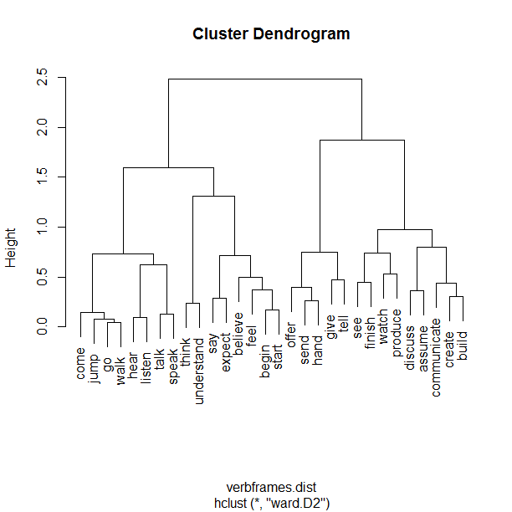

Slide 38
Comparing properties of clusters
> verbs1 <- c("come", "go", "walk", "jump")
> verbs2 <- c("hear", "listen", "talk", "speak")
> cluster1 <- verbframes.short[rownames(verbframes.short) %in% verbs1,]
> cluster2 <- verbframes.short[rownames(verbframes.short) %in% verbs2,]
Compute the mean PMIs and the differences between them:
> cluster1.means <- colMeans(cluster1)
> cluster2.means <- colMeans(cluster2)
> diff <- cluster1.means - cluster2.means

Slide 39
Making a “snake plot”
> plot(sort(diff), 1:length(diff), type = "n", xlab = "cluster 2 <–-> cluster 1", yaxt = "n", ylab = "")
> text(sort(diff), 1:length(diff), names(sort(diff)))

Slide 40
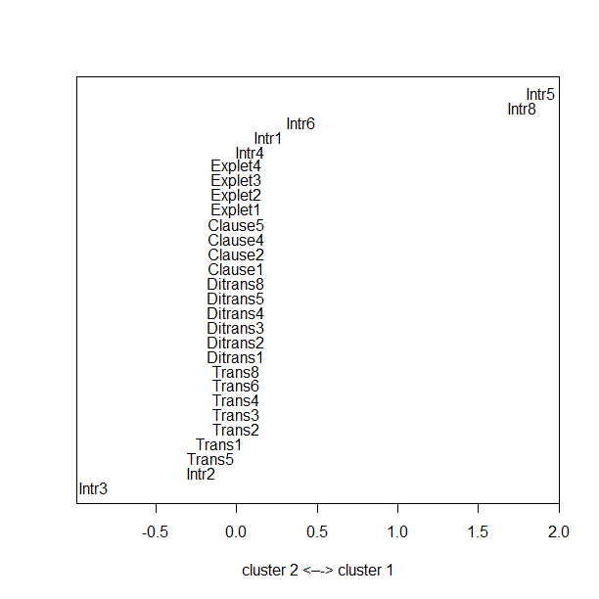

Slide 41
Distinctive subcategorization frames
Frame Intr3: V + Oblique
Talk to your academic adviser, see what they recommend.
Frame Intr5: Subj + V + AdvMod
Now comes the fun part.
Frame Intr8: V + AdvMod
Coming soon!

Slide 42
Exercise
Compare the clusters [give, tell] and [offer, send, hand]. What is the difference?

Slide 43
References
Deerwester, S., Dumais, S.T., Furnas, G.W., Landayer, T.K., & Harshman, R. (1990). Indexing by Latent Semantic Analysis. Journal of the American Society for Information Science 41: 391–407.
Everitt, B.S., Landau, S., Leese, M., & Stahl, D. (2011). Cluster Analysis (5th ed.). Chichester: Wiley.
Firth, J.R. (1957). A synopsis of linguistic theory 1930–1955. In J. R. Firth (Ed.), Studies in Linguistic Analysis, 1–32) Oxford: Blackwell.
Harris, Z. (1954). Distributional structure. Word 10(2/3): 146–162.
Levshina, N., & Heylen, K. (2014). A radically data-driven construction grammar: Experiments with Dutch causative constructions. In R. Boogaart, T. Colleman, & G. Rutten (Eds.), Extending the Scope of Construction Grammar, 17–46. Berlin/New York: Mouton de Gruyter.
Lin, D. (1998). Automatic retrieval and clustering of similar words. Proceedings of the 17th International Conference on Computational linguistics, Montreal, Canada, August 1998, 768–774.
Perek, F. (2016). Using distributional semantics to study syntactic productivity in diachrony: A case study. Linguistics 54(1): 149–188.
Schütze, H. (1992). Dimensions of meaning. In Proceedings of Supercomputing 92, 787–796. Minneapolis, MN.

